Slide 1
MOECC Update
Presented to: NEOWWC in Sudbury
May 2018
Satish Deshpande, MOECC

Slide 2
Purpose
To provide an overview of:
Ontario Drinking Water Quality Standards
Regulatory Changes in the past 3 years
New and revised standards
Lead monitoring for sensitive populations
Health Canada’s Proposed Guideline on Lead
Consultations on Copper and QMRA
HAAs monitoring/ Algal Bloom monitoring

Slide 3
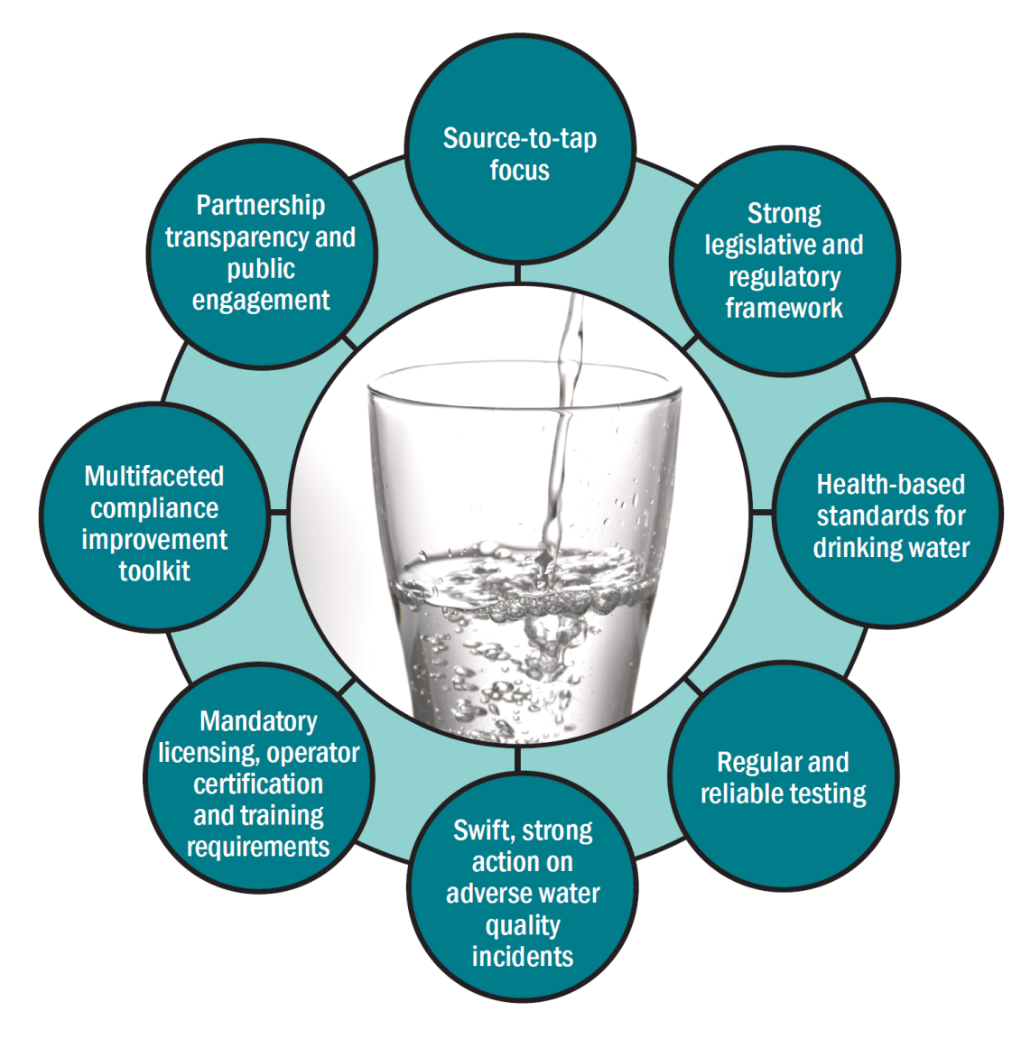
Drinking Water Safety Net
The contents in this presentation represent various aspects of the Safety Net.

Slide 4
Principles used in developing Drinking Water Quality Standards
Generally accepted scientific principles that include peer-reviewed publications.
Exposure from drinking, dermal & inhalation routes (Health Canada).
Life-time exposures:
Carcinogenic substances: ~ 10⁻⁵ to 10⁻⁶ life-time risk,
Non-carcinogenic substances: drinking water accounts for ~ 20% of reference dose.
Analytical capability & available treatment technology.

Slide 5
What is a Standard?
A numerical value in O. Regulation 169/03.
Represents aspects of the drinking water program:
It reflects practices related to source water selection, treatment technology, and monitoring;
Trends in the level of a given compound could be used to assess local threats hence mitigation measures even if the level does not exceed a prescribed standard;
Development of a standard considers more than a health basis.

Slide 6
Ontario Drinking Water Quality Standards
Generally adopted from Canadian Drinking Water Quality Guidelines (CDWQGs) after public consultation via the Environmental Bill of Rights Environmental Registry.
CDWQGs are developed through a national process managed by federal, provincial and territorial government representatives.
Ontario may develop provincial standards when substances not identified as a national priority or when the approval date for a CDWQG does not meet Ontario’s needs.

Slide 7
Ontario Drinking Water Quality Standards
Legally enforceable under O. Reg. 169/03 and in Schedules 23 and 24 of O. Reg. 170/03.
Microbiological, chemical, and radiological parameters.
Health Related:
Maximum Acceptable Concentration (MAC) established using best available information.
Technical Support Document for Ontario Drinking Water Standards, Objectives and Guidelines:
Additional information on individual parameters.
Turbidity is enforced as filter performance criteria in the “Procedure for Disinfection of Drinking Water in Ontario”.

Slide 8
Development of Health Canada Guidelines
Priority Setting: Is substance found at levels likely to pose human health threats? Is there a geographic scope? If standards exist, is there new scientific information of concern?
Risk Assessment: Scientific evaluation of health effects or other impacts of exposure.
Risk Management: Evaluation of implementation issues - availability of testing methods, treatment technologies, compliance measures, costs and health benefits.
Peer-Review Process: Input from Provincial-Territorial partners and peer-review with academics/other agencies.
Stakeholder Consultation: Health Canada carries out a national consultation and a review of the comments. The document is then reviewed by the Federal-Provincial-Territorial Committee on Health and the Environment before being posted as a Canadian Drinking Water Quality Guideline.

Slide 9
Ontario’s Standard Setting Process
Federal/Provincial/Territorial Committee on Drinking Water (CDW)* proposes a value used in establishing Canadian Drinking Water Quality Guideline.
Federal Consultation
Final Canadian Drinking Water Quality Guideline (CDWQG)
Federal Canadian Drinking Water Quality Guideline (CDWQG)
Preliminary Draft Standard
Peer Review
WHO, USEPA,
EU, Australia
Consultation with Ontario Advisory Council on Drinking Water Quality and Testing Standards (ODWAC)
* MOE sits on the CDW
Provincial Ontario Drinking Water Quality Standard (ODWQS)
MOECC reviews CDWQG with regards to setting an ODWQS
EBR Consultation (Additional Regulatory Amendments identified)
Proceed to LRC/Cabinet with Regulatory Amendment to O. Reg 169/03
Post EBR Decision for Final ODWQS via Regulatory Amendment to O. Reg 169/03
Propose new/updated ODWQS
ODWAC provides recommendation to Minister
Additional Stakeholder consultation

Slide 10
Objectives and Guidelines
Listed in the “Technical Support Document for Ontario Drinking Water Standards, Objectives and Guidelines”
Aesthetic Objectives (AO)
set for parameters that may impair taste, odour, colour, or water quality e.g. copper, chloride, total dissolved solids
for certain chemicals a health standard and an aesthetic objective may be established e.g. 2,4-dichlorophenol, 0.9 mg/L (MAC) and 0.003 mg/L (AO)
Operational Guidelines (OG)
established to ensure efficient and effective treatment objectives e.g. aluminum, alkalinity, pH

Slide 11
Amendments to O. Reg. 169/03
The MOECC has carried out three consultations on the Environmental Bill of Rights Environmental Registry (EBR) for amending the Ontario Drinking Water Quality Standards as follows:
December 18, 2014 to February 16, 2015
(EBR 012-1594)
August 15, 2015 to September 28, 2015
(EBR 012-4213)
August 23, 2016 to October 07, 2016
(EBR 012-8244)
11

Slide 12
Summary Table of EBR Consultations 012-1594 and 012-4213
Parameter (mg/L) | Previous Standard (mg/L) | Original EBR Consultation 012-1594 (mg/L) | Consequence of Consultation
Arsenic | 0.025 | 0.010 | Implementation date extended to January 1, 2018
Benzene | 0.005 | 0.001 | Adopted as an ODWQS July1, 2016
Carbon Tetrachloride | 0.005 | 0.002 | Adopted as an ODWQS July1, 2016
THMs | 0.100 | Maintain current standard of 0.100 | No Change but clarified calendar quarters and calculations
Vinyl chloride | 0.002 | 0.001 | Adopted as an ODWQS July1, 2016
Haloacetic Acids (HAAs) | N/A | 0.080 | Implementation date extended to January 1, 2020
Chlorate/chlorite | N/A | 1/1 | Adopted as an ODWQS July1, 2016
2-methyl-4-chlorophenoxyacetic acid (MCPA) | N/A | 0.1 | Adopted as an ODWQS July1, 2016

Slide 13
Summary Table of EBR Consultations 012- 8244
Parameter (mg/L) | Current Standard (mg/L) | EBR Consultation (mg/L) | Amendment to O. Reg. 163/03 to adopt/revoke these parameters as ODWQS
Selenium | 0.01 | 0.05 | July 1, 2017
Nitrate + Nitrite | 10 | Revoke | Revoked on July 1, 2017
Tetrachloroethylene | 0.03 | 0.01 | July 1, 2017
Toluene | NA | 0.06 | July 1, 2017
Ethylbenzene | NA | 0.14 | July 1, 2017
Xylene | NA | 0.09 | July 1, 2017
Methyl-t-butyl ether | NA | NA | July 1, 2017

Slide 14
Removal of Legacy Pesticides EBR 012-4213
To reduce burden it was proposed that thirteen (13) ‘legacy’ pesticides be removed from regulations (O. Reg. 169/03 & O. Reg. 170/03) because no longer in commercial use and have not been detected in drinking water samples for >10 years.
Revoked on July 1, 2016 and also de-listed from the federal guidelines.
These ‘legacy’ pesticides would continue to be monitored as part of pesticide scans by the ministry
Aldicarb 9. Lindane (Total)
2. Aldrin + Dieldrin 10. Methoxychlor 3. Bendiocarb 11. Parathion 4. Chlordane (Total) 12. Temephos 5. Cyanazine 13. 2,4,5-Trichlorophenoxy acetic acid (2,4,5-T) 6. Dichlorodiphenyltrichloroethane (DDT) + metabolites 7. Dinoseb 8. Heptachlor + Heptachlor Epoxide

Slide 15
Pesticides without Standards
Historically, the detection of pesticides without standards in drinking water would result in an Adverse Water Quality Incident (AWQI).
As of July 1, 2017, the detection of these pesticides (i.e. without an ODWQS) will only result in an AWQI if the detected level is above 100 ng/L.
However, the result (pesticide, level detected) is still uploaded to the ministry so we can assess if a standard is required.

Slide 16
Aesthetic Objectives
CHEMICAL | NEW AO (mg/L) | OLD AO (mg/L) | DATE | COMMENTS
Ethylbenzene | 0.0016 | 0.0024 | July 1, 2017 | More stringent
Methyl-t-butyl ether | 0.015 | NA | July 1, 2017 | New AO
Xylenes | 0.02 | 0.3 | July 1, 2017 | More stringent

Slide 17
Lead Regulations
Since 2007, O. Reg. 243/07 has set the flushing and sampling of drinking water requirements for Schools, Private Schools and Child Care Centres*
In support of these requirements the ministry created and implemented an inspection program, a suite of education and outreach material, template records and a self-reporting initiative.
*formerly known as Day Nurseries

Slide 18
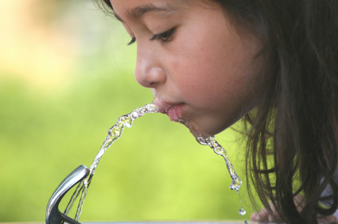
Background
The regulation was first amended in 2009 to introduce ‘co-location’, a reduced sampling schedule and to require Child Care Centres (CCC) constructed post-1990 to begin collecting samples
The focus of the regulation promoted exposure in Lead reduction:
Flushing
Sampling
Reporting
Corrective Actions
Record Keeping

Slide 19
Gaps identified in the Pre-2017 Regulation
No requirement to sample fountains
No requirement to rotate sampling locations
No allowances for NSF certified filters or other lead reduction products
No requirement to sample more than one fixture

Slide 20
2017 Amendments
Mandatory sampling of drinking taps and water fountains.
Addressing water conservation efforts by reducing the need for flushing in certain situations.
Formally recognizing the use of NSF certified filters.
Standardizing a minimum level of corrective actions.

Slide 21
Sampling
The following new requirements apply to ALL facilities (including those co-located within Schools)
Ensure that samples are collected from every drinking water fixture* that has not yet been sampled under O. Reg. 243/07
Multiple sets of samples can be collected at a facility on the same day
New requirements to sample at all drinking water fixtures supersede existing reduced sampling schedules
*drinking water fixture – a drinking water fountain or tap that is used to provide water for food prep or consumption
Notes:
Once all drinking water fixtures have been sampled, on an ongoing basis, annual or reduced schedule samples can be taken and shared between facilities in co-located situations.
The reduced sampling schedule in subsection 5(2.1) of O. Reg. 243/07 will still be available
The sampling window of May-October remains in effect

Slide 22
Flushing Amendments
Flushing would not be required* at certain fixtures if…
The most recent ‘standing’ sample result was at or below 1ug/L.
An NSF certified filter is installed at the fixture, the verification sample result was at or below 1ug/L and records are maintained to document the filter cartridges being changed.
The tap is not accessible to children.
*end-of-branch flushing would still be required at all facilities.

Slide 24
Health Canada’s Proposed Guideline on Lead (1/3)
Health Canada consulted on a more stringent guideline for lead in drinking water in 2017.
“A maximum acceptable concentration (MAC) of 0.005 mg/L (5 µg/L) is proposed for total lead in drinking water, based on a sample of water taken at the tap and using the appropriate protocol for the type of building being sampled. Every effort should be made to maintain lead levels in drinking water as low as reasonably achievable (or ALARA)”.
The health basis of the guideline is a decrement in IQ and is observed at any level of lead.

Slide 25
Health Canada’s Proposed Guideline on Lead (2/3)
Health Canada is setting a precedent with the health basis of the guideline value and recommending that the level be determined at the tap using appropriate monitoring methodology.
Lead monitoring strategies are provided in the document.
The document makes reference to filters at the tap as a means of reducing exposure to lead.
A final document has not been posted as of this date (May 16, 2018).

Slide 26
Health Canada’s Proposed Guideline on Lead (3/3)
The document is still being revised.
The ministry will review the document when it is posted and carry out a consultation on the Environmental Registry.
Any comments that are submitted will be considered.

Slide 27
Health Canada’s Proposed Guideline on Copper
Health Canada is currently consulting on a guideline for Copper in Drinking Water and proposes:
Aesthetic objective (1 mg/L), and
Health-based MAC (2 mg/L).
The MAC is based on the protection of bottle-fed infants such that no ill effects are observed.
There is a linkage to corrosion control and lead with a focus on proper monitoring.
Monitoring for copper is also a challenge as the sampling protocol is important.
Consultation ends on May 25, 2018

Slide 28
Health Canada’s Proposed Guidance on QMRA (1/3)
Health Canada has developed a guidance (not a guideline) document for applying Quantitative Microbial Risk Assessment to drinking water treatment processes.
The consultation for this document ended on May 11, 2018.
QMRA is a useful tool to assess health risks from pathogens in drinking water.

Slide 29
Health Canada’s Proposed Guidance on QMRA (2/3)
The Excel model which can be downloaded can be used:
to determine critical control points in the drinking water system;
to determine specific treatment processes to reduce the levels of various pathogens;
to predict the consequences of various management options for reducing risk;
to identify and prioritize research needs; and
to assist in epidemiological investigations.
The model can provide estimates of treatment barrier efficiency.
Hence, it can be used to assess how changes in source water characteristics could affect the treatment efficiency.

Slide 30
Health Canada’s Proposed Guidance on QMRA (3/3)
This can assist in tasks such as:
prioritizing hazards;
identifying alternative risk management priorities and options;
selection of appropriate interventions;
cost-benefit analysis of risk management actions; and,
setting of health-based performance targets for various processes in the drinking water system.

Slide 31
Guidance for Developing an HAA Monitoring Program
General rule: all samples described below should be obtained from a sampling point where the free (combined) chlorine residual is maintained over 0.2 mg/L (1.0 mg/L), respectively.
First Year of Sampling | Second Year of Sampling | Third Year of Sampling
Established THM sampling point may be appropriate provided the chlorine concentrations are as described above. If the residual is below the concentrations listed, use a nearby sampling point that meets the recommended residual. | Where a system re-chlorinates via a booster station, samples should be obtained in the distribution system after the booster station. | If neither of the running annual averages for HAAs calculated (after year one and two) were higher than one-half of the standard (40 μg/L), the sampling point used in the first year of sampling can be used for compliance in future years.
 | If the system does not have booster stations, but has storage facilities where re-chlorination occurs, the sampling should be at points after the storage facilities. | If one of the running annual averages is over 40 µg/L, the municipality is required to choose a third sampling point using the same criteria as the second year, and obtain samples from this sampling point for the third year. The municipality will then be required to sample from the point which had the highest individual sample result for future years.
 | If the system does not re-chlorinate, but has storage the sampling should be at points after the storage facilities.
 | If the system does not re-chlorinate nor have storage, obtain the sample from another point in the distribution system.
The outlined sampling plan is intended to be flexible and recognizes that municipalities have been sampling for HAAs since 2017.

Slide 32
Ontario Algal Bloom Monitoring Update
Sample from June to October.
Visual observation is key for all systems.
All blooms regarded as potentially toxic.
Test raw and treated water for microcystins if bloom observed or system has a history with blooms.
Testing begins at least weekly and increases to daily with detection of a bloom.
Treated sample to be taken at point of entry to distribution system.

Slide 33
Thank you….
Acknowledge colleagues from MOECC:
Aziz Ahmed
Rob Dumancic
Aleksandra (Ola) Sokolowski
Questions and comments welcome.

