Slide 1
55th Annual Northeastern Ontario Water Works Conference
May 16, 2018

Slide 2
Our Vision
“To be the Leading Resource for
Ontario’s Water Community”

Slide 3
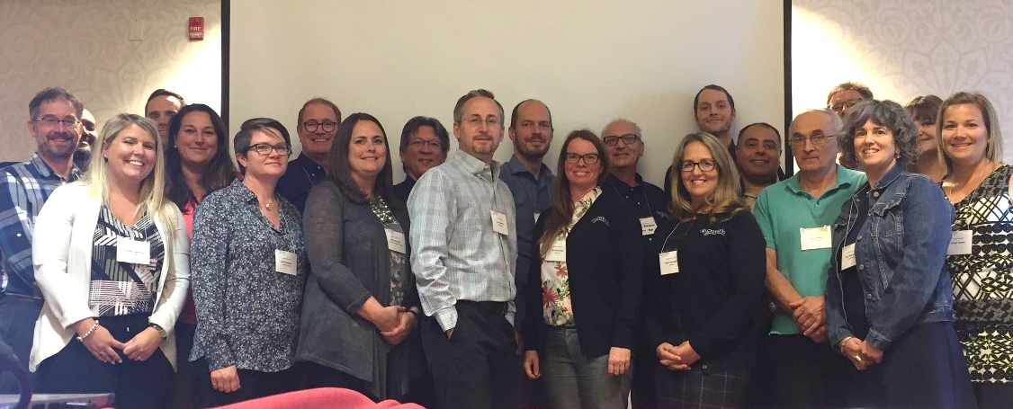
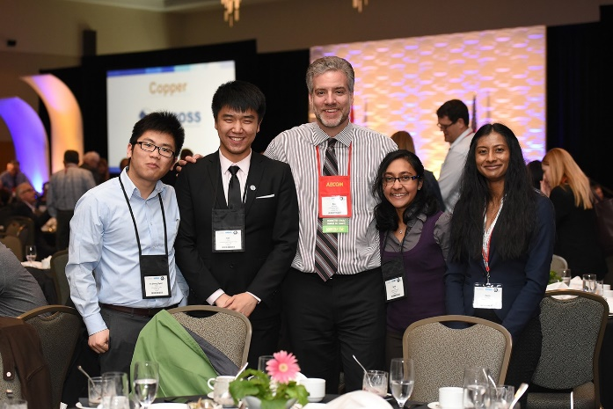
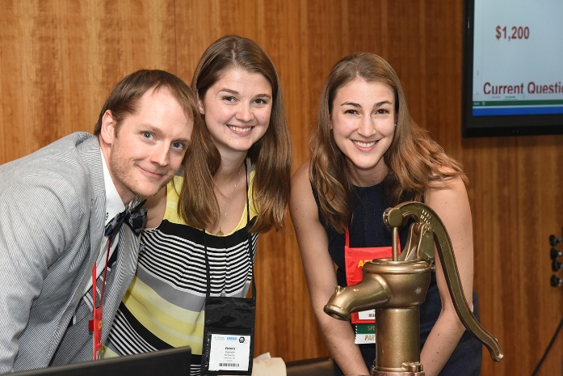
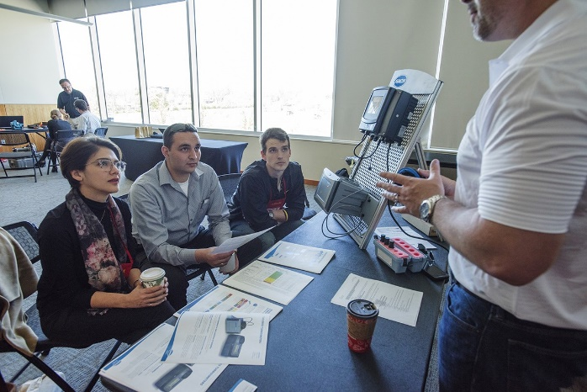
Our Members
Stay Informed
Stay Connected
Develop Your Career

Slide 4
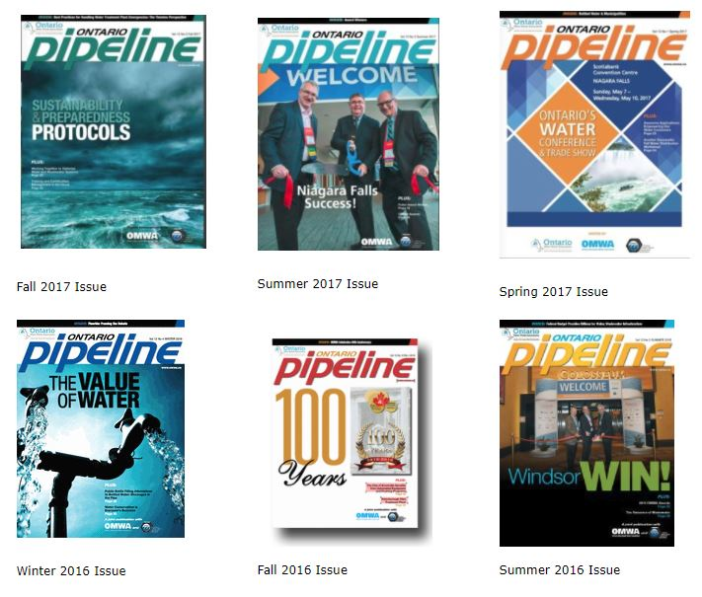
Pipeline Magazine
Our Quarterly Publication featuring Case Studies, Research, and Association News is a Member Benefit
“If you want Ontario's water community to see something, this is the place”
-2018 readership survey

Slide 5
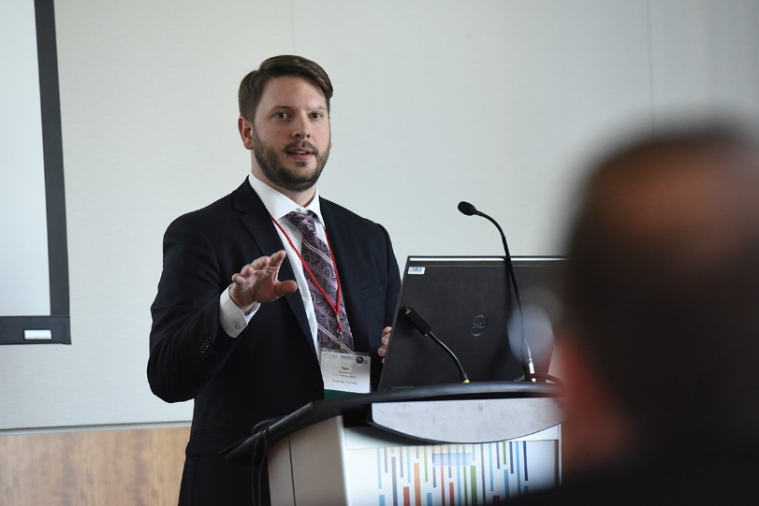
Annual OWWA Seminars for Continuing Education
Technology
Best Practices
Management
Regulations
Operator Certification
University Research

Slide 6
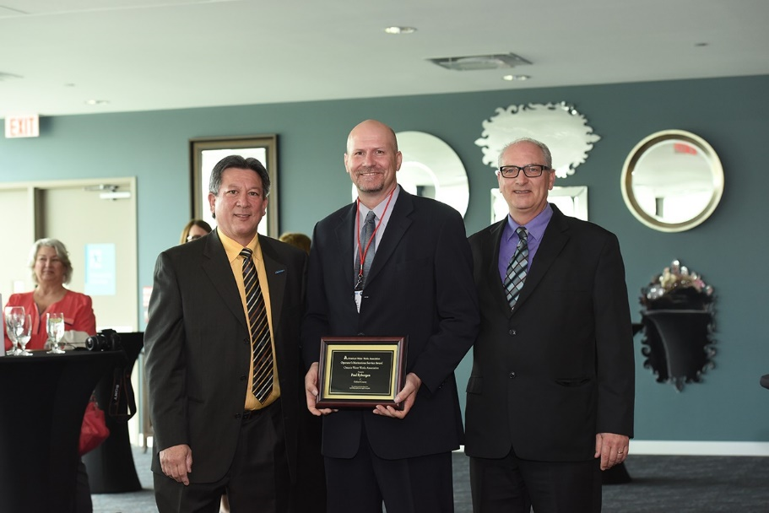
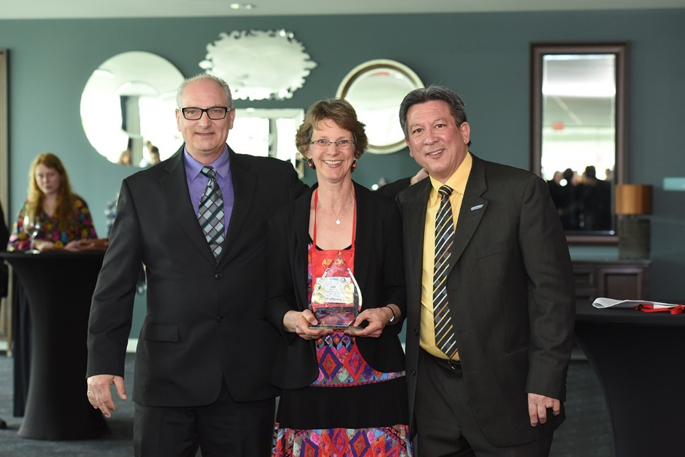
And the Award Goes to…
The Call for Award Nominations goes out in August every year. Visit owwa.ca to nominate a colleague for an OWWA Award!

Slide 7
OWWA in 2018
1500 members
80 municipalities & utilities
45 service providers
17 Volunteer Committees
2 Advisory Panels

Slide 8
Web: www.owwa.ca Email: waterinfo@owwa.ca Tel: 416-231-1555

